Slide 1


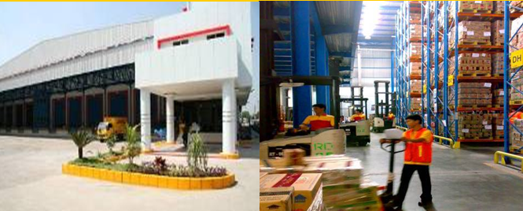

CDC O6 - Surabaya
Wed, 22 Feb 2012

Slide 2
Structure of Customer Service & Logistic
Business Partner for Customer Development Team
Scope: Order, Warehouse, Distribution & Transport Execution
SC
Cust.Service
CSOG
Logistic
CSMT DA
CS DIST
CS IC
RSE
WAREHOUSE
TRANSPORT
CDC West (Linfox)
CDC East (DHL Exel)
DC OI/Depot (K-Log)

Slide 3
Role & Responsibilities ..
BOF & CDC Operation
Order Execution: On time delivery in the Right product, Place & Quantity.
Service level / KPI
Notes:
Order Execution: on time delivery in the right product, place & quantity

Slide 4


Flow of Goods ..
Depots (10)
Central WH (2)
Factory
Distributors & MTKA
Export
Distributors & MTKA RECEIVES the product from Unilever both from CDC (Central WH) and Depots

Slide 5
Indonesia Distribution Network
MED
MED
MED
MED
PKB
PKB
PKB
PKB
MDO
MDO
MDO
SMD
MDO
PON
PON
PON
PAD
PON
PAD
PAD
JAMBI
PLB
PLB
BMS
BMS
BMS
BMS
UPD
UPD
UPD
LAM
UPD
LAM
SMG
JKTE
SMG
JKTE
SBYW
SBYW
JKTW
JKTW
DPS
BDG
BDG
YOG
YOG
SBYE
SBYE
CDC (2)
REGION (3)
Sales area ( >30)
Depot Warehouse ( 10)
GT (>300) & MT Distributor (>25 ) & MTKA >570

Slide 6
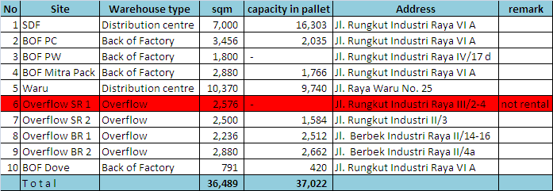
CDC 06 SBY - Distribution Network ..
MED
MED
MED
MED
MED
PKB
PKB
PKB
PKB
PKB
PON
MDO
MDO
MDO
MDO
SMD
MDO
PON
SMD
PON
PON
PAD
PON
PAD
PAD
JAMBI
PAD
JAMBI
PLB
PLB
PLB
BJM
BMS
BMS
BMS
LAM
BMS
JKT
UPD
UPD
UPD
LAM
UPD
LAM
JKTE
SMG
JKTE
SBYW
MKS
SBYW
SBY
JKTW
JKTW
DPS
BDG
BDG
YOG
YOG
SBYE
SBYE
DPS
STO 10 Depots ULI ( 344.612 CS /wk, contrib 44% )
SO Dist & MTKA ( 440,360 CS / wk , contrib 56% )
SO → JV (72%) , OI (28%)
NB of Drop Points : 315 Drop point
Distributor - 224 ( ord. Contrib 66%)
MTKA - 91 (ord contrib (34%)
Product Export

Slide 7








Order and Delivery Process..
Order Validation
Expedition Report
Send Expedition Report
Synchronization
SAP
Data interface:
SKU/Desc
-Barcode
Price
Total PO
Completeness
Maintain
PO Electronic
Order Processor
PO Manual
Order Entry
PO Checking:
SKU/Description
Barcode
Price
Qty
Total PO
CD - ASM Team
MBAU/Depo
CDC/Depot
Allocation
Forecast (Distributor)
Load Planning
Delivery Monitoring / Daily Monitoring :
Est. Arrived
Delivery Qty
CCF/ CCFOT
Total PO
Send PO (Store MTKA)
Billing -Invoice
Assembling &
Loading
Picking
DELIVERY
Cust. MTKA/ Distributor
POD – Arrival Date

Slide 8
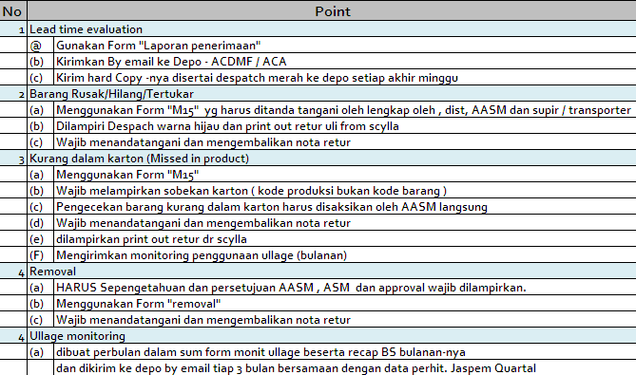
Activities related goods received ..
file

Slide 9
How do we monitor ..
Case fill = Ship versus Order
CCFOT (Customer Case fill On Time)= Deliver On time vs Order
Root Cause Analysis, Level 1 → 4
Daily Reporting
KPI
BW

Slide 10
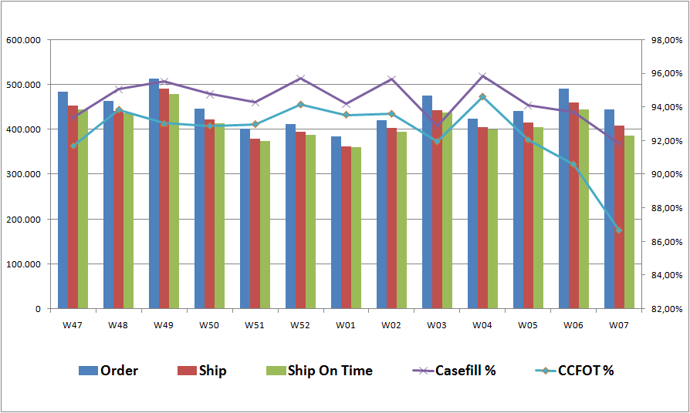
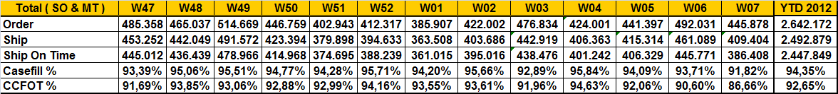
CDC 06 SBY - Service Level 2012..

Slide 11
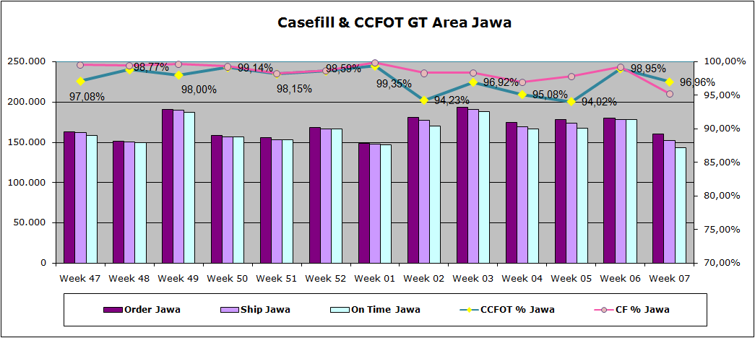
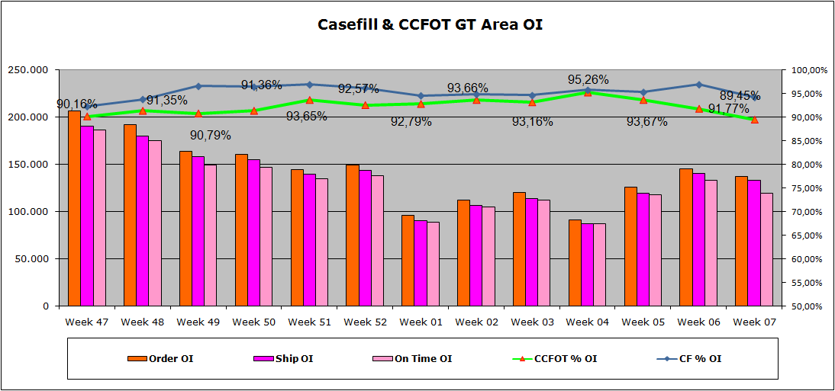
CDC 06 SBY – Service Level 2012 for Distributor..

Slide 12
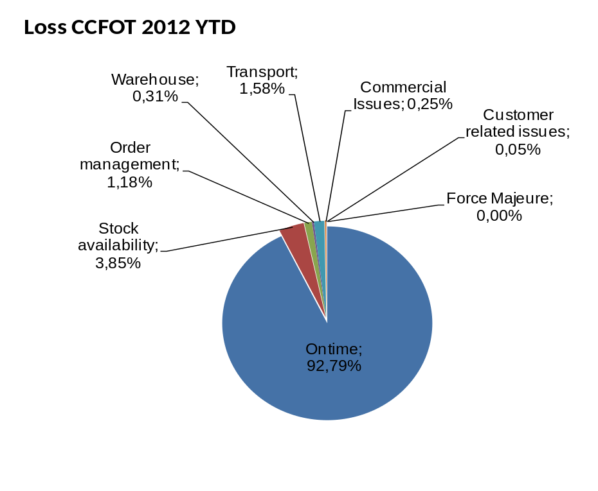
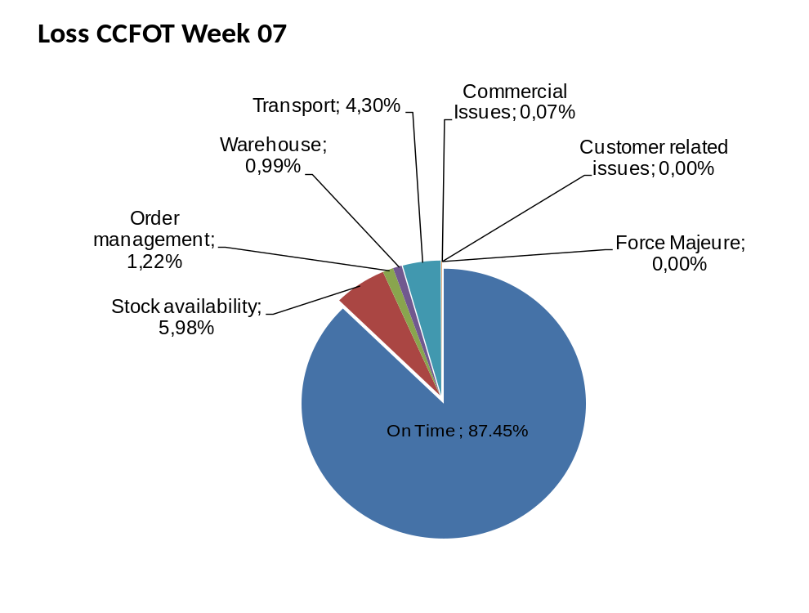
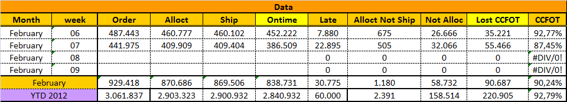
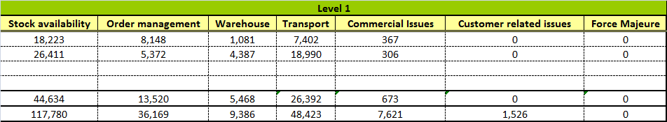
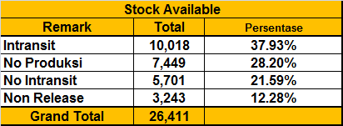
Loss tree 1st Level..

Slide 13
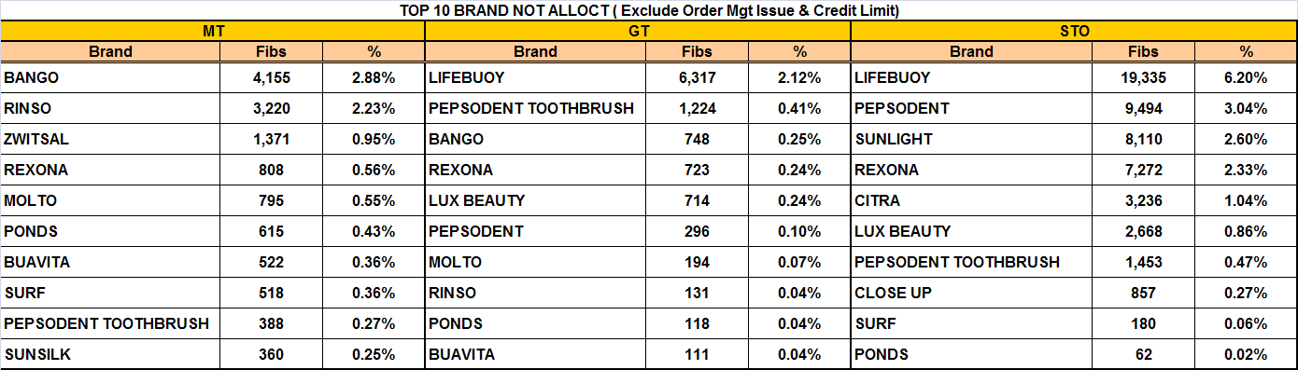
Top Shortage Sku..
MT : - Bango Kecap Manis Pouch 220 ml & Manis Ref 600 ml
- Rinso Matic Front Load 1 kg & Rinso Antinoda B01 900 gr
- Zwitsal BB Bath N Hair &Bod & Mlk&Hon Pch 500 ml
GT : - Not alloct tersebut terjadi pada week 01 s/d 07
- Lifebuoy TS Red TTL Prot 80 gr & TProtect 70 gr
- Pepsodent TB Care Clean SGL/48 & Sensitive/48
- Bango Manis Ref 600 ml & Soya Manis 275 ml.
STO : - Lifebuoy TS Red TTL Prot 80 gr & TTPr MP 115 gr
- Pepsodent White 75 & Complete 160 gr
- Sunlight Lime Ref 800 & 400 ml

Slide 14
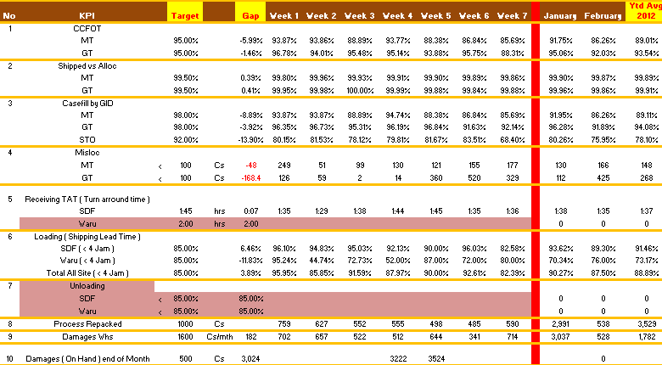
KPI DHL Exel..

Slide 15

-Thank you-
Together We Can!

